Slide 1
Memory
PSY 101, BRAC University

Slide 2
Remembering and forgetting
Why do we remember what we experience?
Why do we forget what we experience?

Slide 3
Bottom-Up and Top-Down Influences on Memory
Bottom-Up
perceptual experience what we see and hear
Top-Down
prior knowledge, concepts, expectations, subsequent experience and which grows over time
Notes:
Bottom-up memory might be really
the video camera if we had it, an actual recording of what we hear, what we see,
what we experience out there in the world. Top-down processes are the mental
things we have in our minds that let us interpret what's out there, concepts,
expectations. Also, it turns out, you'll see that subsequent experiences go back and
change memories from prior times. And which of these things, the bottom-up
original experience, or the top-down interpretation grows over time to constitute
your memory?

Slide 4
Memory processing in psychology involves three stages
Encoding: The first step in creating a memory, where the brain receives sensory information and transforms it into stored information.
Storage: The ability to maintain information over time.
Retrieval: The ability to access stored information when needed.

Slide 5



The Three-Stage Model of Memory
Sensory Memory
Short-Term Memory
Long-Term Memory
Rehearsal
Image by MIT OpenCourseWare.
Notes:
So we can have a very simple model of memory, a flash for a moment. I'll give you
an example of how people test this, a sensory memory, very tiny moments only.
Short-term memory that you can rehearse in some cases. Somebody tells you a
number, And you can repeat it over and over again. You have that capacity. And
then long-term memory, things that last for a long time.
When we talk about the brain organization of human memory, we'll say that shortterm
memory is probably, lasts seconds. And everything after that is long-term
memory. Now, of course, if you just experienced something, you'd remember it
better. If it's a week, a month, a year, five years from now, most likely less better. So
time passes. But we think almost all of that is in the context of long-term memory
capacities of your mind.

Slide 6
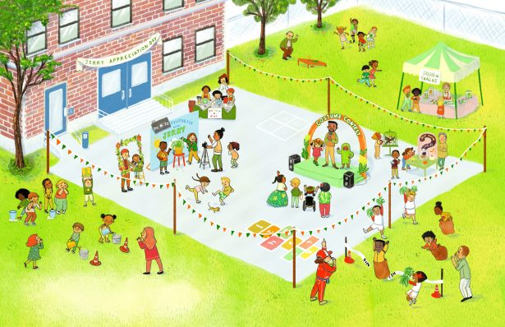

Slide 7
What have you just seen?

Slide 8
Sensory Memory
Sensory memory is a mental representation of how environmental events look, sound, feel, smell and taste. It includes a long-term component useful for such activities as recognizing a color or a familiar voice. However, most vivid details of sensory memory seem to fade quickly.

Slide 9
Test of Digit Span
Span of 4: 6 1 9 4
Span of 5: 3 7 8 5 2
Span of 6: 9 6 5 2 8 3
Span of 7: 4 2 6 9 8 5 1
Span of 8: 8 1 6 3 7 2 4 9
Span of 9: 6 2 5 7 3 4 9 8 1
Span of 10: 9 3 8 2 4 7 1 5 3 6
Span of 11: 5 8 1 4 7 9 3 2 6 1 7
Notes:
INSTRUCTORS:
ASK A VOLUNTEER TO CLOSE THEIR EYES. READ EACH BULLET POINT AND HAVE THEM REPEAT THE NUMBERS BACK TO YOU. THEY WILL NOT BE ABLE TO GET PAST 8 OR 9. THAT IS THE LIMIT OF HUMAN SHORT TERM MEMORY.

Slide 10
Short-term memory
Limited Capacity
7 +/- 2 chunks
Prior knowledge defines chunks, allows for more information to be retained in memory, may also miscode information
Notes:
There used to be some confusions about this. Because they would say kids in
different countries have different limits. And they'd say our country is smarter than
your country, or our educational system is better than your educational system. It
turned out that all of that got equated around the world if you counted up the
number of syllables that are in the digits. The real unit of memory here are syllables.
So in English, most of the numbers are one syllable. 1, 2, 3, 4, 5, 6 are all one
syllable. 7 gets two. 8 is one syllable. 9 is one syllable.
In some other languages, the words that go with the digits are two syllables. So
countries that have two syllables, they have lower spans not because they were
dumber or had a worse education system. It's because the real unit is number of
syllables. Because you're hearing it. It's language. So around the world, it's the
fundamental capacity of the human mind is that you're limited to these kinds of stuff.

Slide 11
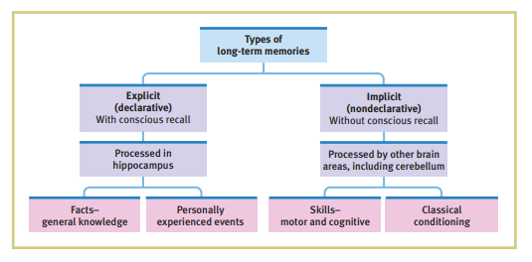
Long Term Memory

Slide 12
Implicit memory Unconscious memory that is recalled without effort or awareness. For example, you might remember how to ride a bike without consciously thinking about it.
Explicit memory Conscious memory that requires effort to retrieve. For example, you might recall items on a list.
Implicit memory is unconscious recall, like skills and habits (e.g., riding a bike), while explicit memory is conscious recall of facts and events (e.g., remembering a birthday). Both are vital components of long-term memory, with implicit being more about “knowing how” and explicit about “knowing that.”

Slide 13
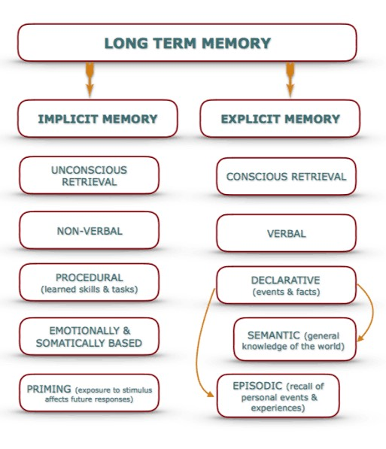

Slide 14
What letters do you see?
G D C E I A H B F
Notes:
And people use the word "chunking" as the way in which you use your background
knowledge to get big pieces of information stored that are better than you think for
short-term memory limits. So here's a quick one. I need a volunteer.
SHOW CLASS THIS AND THEN MOVE TO NEXT BLANK SLIDE, ASK THEM TO REMEMBER

Slide 16
What letters do you see?
A B C D E F G H I
Notes:
SHOW CLASS THIS AND THEN MOVE TO NEXT BLANK SLIDE, ASK THEM TO REMEMBER

Slide 17
Notes:
The same letters, it's just that now you see the chunks. And you can map them onto background knowledge. Much much easier to remember!

Slide 18
WHAT WORDS DO YOU SEE
LEAF PAPER SEAT TIRE CAR FISH ROCK WIRE WHEEL BEACH TREE BOY RADIO RULE

Slide 20
WHILE I WAS WALKING THROUGH THE WOODS A RABBIT RAN ACROSS MY PATH
Notes:
you can use your background knowledge of what does a sentence mean? What's
the ergative syntax? All your background knowledge can be applied. Again, the
power of background knowledge is immense.
I can tell you that if you go work somewhere, or if you're working in a lab now, or if
you're working in any place, you might be impressed by people who are older than
you, and what they know, and what they can learn and pick up. It's background
knowledge, background knowledge, background knowledge. It lets you quickly
understand an idea, because you can interpret it from prior ideas that you know,
quickly read a paper, because you can slot it into prior things you know. Background
knowledge is incredibly powerful to let you discover the signal and get a lot of the
specific information in any kind of information out there.

Slide 21
A few more things about memory…
Primacy and recency
Deep vs shallow encoding
Context matters!
Organization

Slide 22
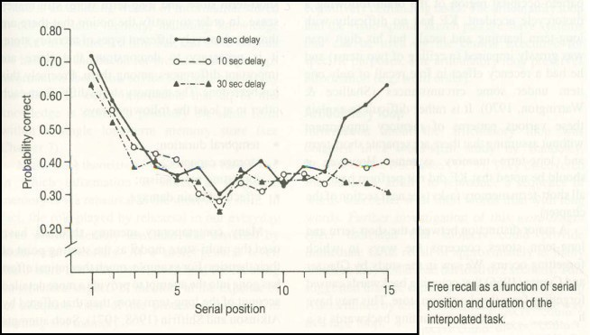
Primacy Effect = LTM Recency Effect = STM
Courtesy of Elsevier, Inc., http://www.sciencedirect.com. Used with permission. Source: Glanzer, M., and A. R. Cunitz. "Two Storage Mechanisms in Free Recall." Journal of Verbal Learning and Verbal Behavior 5, no. 4 (1966): 351-60.
Notes:
So this is correct. High is correct. This is what order the word was in the first word
you heard, say the fifth. This experiment is 15 words. You can see that. Here's their
performance.
Two things are noteworthy. People do best for the first couple of words. And
sometimes they did best for the last couple of words.
So here's three delays. These delays are zero seconds what we did. You get the
list, you immediately write them down and recall them verbally. That's zero,
immediate. Or I wait 10 seconds and then say, now recall. Or I wait 1/2 minute and
say, now recall.
Now memory for the first two items is what's called a primacy effect. It doesn't
matter. In all three conditions, those are the best two remembered words, on
average, for most of the experiment.
And people think that's a signature of long-term memory. You can get those one or
two words. And then you start to get overwhelmed in long-term memory. Here, you
only get the boost for the last couple of words if there's zero second delay. If there's
10 seconds or 30 seconds delay, no boost.

Slide 23
Ebbinghaus’ Curve of Forgetting
100
90
80
70
60
50
40
30
Immediate recall
Percentage of words remembered
20 minutes
1 hour
9 hours
20
10
0
1 2
6
31
Days since learning
Image by MIT OpenCourseWare.
Notes:
Now Ebbinghaus is one of the founders of experimental studies of memory. And he
was heroic. He would just train himself. He would use nonsense syllables, because
he wanted to get rid of a lot of background stuff, rote memory.
And he would learn thousands of these and then test himself and score himself
10
honestly. He did the bulk of the work on himself. And he discovered something
that's pretty simple, but that has had a huge effect.
So how well do you do s.ince you learned something all in long-term memory if
you're tested immediately? 100% if it's small list and you studied a lot. 20 minutes
later, an hour later, nine hours later, you can see the steep forgetting up until about
10 hours. And then it sort of hangs in there

Slide 24
If word is in CAPITAL LETTERS, Tap left hand
If word is in lowercase letters, Tap right hand

Slide 25
zebra CAR TABLE
mosquito MONKEY
train DESK
termite
BUS
wasp camel SOFA
zebra CAR TABLE
mosquito MONKEY
train DESK
termite
BUS
wasp camel SOFA

Slide 26
WHAT WERE THE WORDS?

Slide 27
If word names a LIVING thing, Tap left hand
If word names a non-living thing, Tap right hand

Slide 28
SPIDER
chair FOX TRUCK
lamp BEE
tiger
boat RABBIT
tractor bed
BUTTERFLY
SPIDER
chair FOX TRUCK
lamp BEE
tiger
boat RABBIT
tractor bed
BUTTERFLY

Slide 29
WHAT WERE THE WORDS?

Slide 30
zebra CAR TABLE
mosquito MONKEY
train DESK
termite BUS
wasp camel SOFA
SPIDER
chair FOX TRUCK
lamp BEE
tiger boat RABBIT
tractor bed
BUTTERFLY
Appearance Shallow Encoding
Poor Memory
Meaning
Deep Encoding Good Memory
Notes:
PEOPLE HAVE A MUCH EASIER TIME REMEMBERING WORDS THE SECOND TIME BECAUSE YOU ARE ENCODING THE MEANING – A DEEPER ENGAGEMENT WITH IT

Slide 31
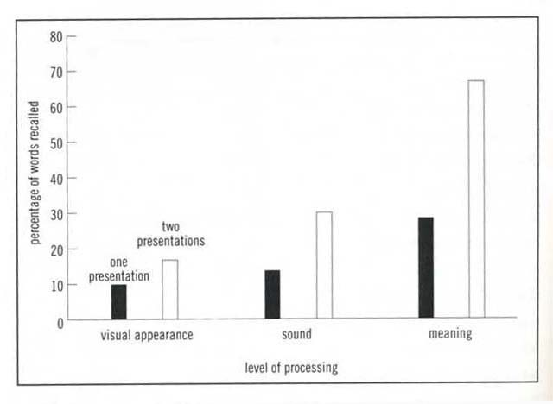
Courtesy of Elsevier, Inc., http://www.sciencedirect.com. Used with permission. Source: Craik, F. I. M., and R. S. Lockhart. "Levels of Processing: A Framework for Memory Research." Journal of Verbal Learning and Verbal Behavior 11, no. 6 (1972): 671-84.

Slide 32
SERVE
EDUCATE
LAWYER
CAREER DUST PHYSICIAN SKILLED
VACUUM DESIGNED HOME
WRITER SCRUB PLUMBER
ELECTRICIAN HOUSEWORK ARTIST BATHE
TEACHER CARPENTER RESPONSIBILITIES FOOD
COOK ENTERTAIN CHILD CARE PROFESSIONAL
PURCHASE CREATIVE

Slide 33
RESPONSIBILITIES
CAREER
HOME
PROFESSIONAL LAWYER PHYSICIAN TEACHER
SKILLED PLUMBER ELECTRICIAN CARPENTER
CREATIVE WRITER ARTIST DESIGNER
HOUSEWORK VACUUM DUST
SCRUB
CHILD CARE BATHE EDUCATE ENTERTAIN
FOOD PURCHASE COOK SERVE
Memory better after semantically organized display than after random display

Slide 34
WHY DO WE FORGET?
passive forgetting? or
interference?
Notes:
One of them is like passive.
Well, I haven't used it in a while. It's just not available anymore. Because time has
passed. It's not been used. It's not available. That's passive forgetting
The other way to think about why we forget is not that it's a passive loss of
knowledge. But that experiences you have after that moment when you learned
something, will go back and write over, and muddy, and confuse your memory for
the original event. It's active interference of subsequent experience.

Slide 35
Interference
Proactive interference
Occurs when you cannot learn a new task because of an old task that had been learnt.
Retroactive interference
Occurs when you forget a previously learnt task due to the learning of a new task.
Notes:
And people have talked about it in two different directions that you can think about
this. One of them is what you call proactive interference where things from before
mess up your learning on something. Or retroactive interference, you already have
the memory. And now new things mess you up and write over the memory. So
memory is threatened by what came before they experience or what happens after
the experience In the way that it interferes with accuracy of memory

Slide 36
FLASHBULB MEMORIES
Emotion important in determining what we remember - surprise & arousal
place
ongoing activity source of news own feelings emotions in others aftermath
Studies that test right after and a year later:
better remembered, but susceptible to distortion
over-confident

Slide 37
What do you do to remember
better when studying?
Notes:
ASK STUDENTS TO SHARE SOME OF THEIR OWN TIPS FOR REMEMBERING – ALL OF WHICH PROBABLY FALL INTO SOME OF THE CATEGORIES WE ARE DISCUSSING

Slide 38
Improving Memory
How can an understanding of memory contribute to more effective study techniques?
Memory research–based strategies include studying repeatedly, making material personally meaningful, activating retrieval cues, using mnemonic devices, minimizing interference, getting adequate sleep, and self-testing.

Slide 39
According to psychology, there are several ways to improve memory, including:
Sleep: Sleep helps the brain organize itself and move information from short-term to long-term memory.
Exercise: Physical activity increases blood flow to the brain, which can improve memory. Exercise can also stimulate new brain cell growth and improve connections between them.
Elaborative rehearsal: This technique helps move thoughts and ideas from short-term to long-term memory.

Slide 40
According to psychology, there are several ways to improve memory, including:
Self-reference effect: Associating memory materials with yourself can improve memory recall.
Reduce interference: Study in a quiet place without distractions.
Brain-training apps: Some evidence suggests that brain-training apps can improve memory and attention span.
Other ways to improve memory include: Staying mentally active, Spending time with others, Staying organized, Eating a healthy diet, and Managing chronic health problems

